Slide 1
Textual analysis of movie reviews
Yixin Luo
Dekun Geng
Haowen Zhu
Yin Hang
Weiqing Li

Slide 2
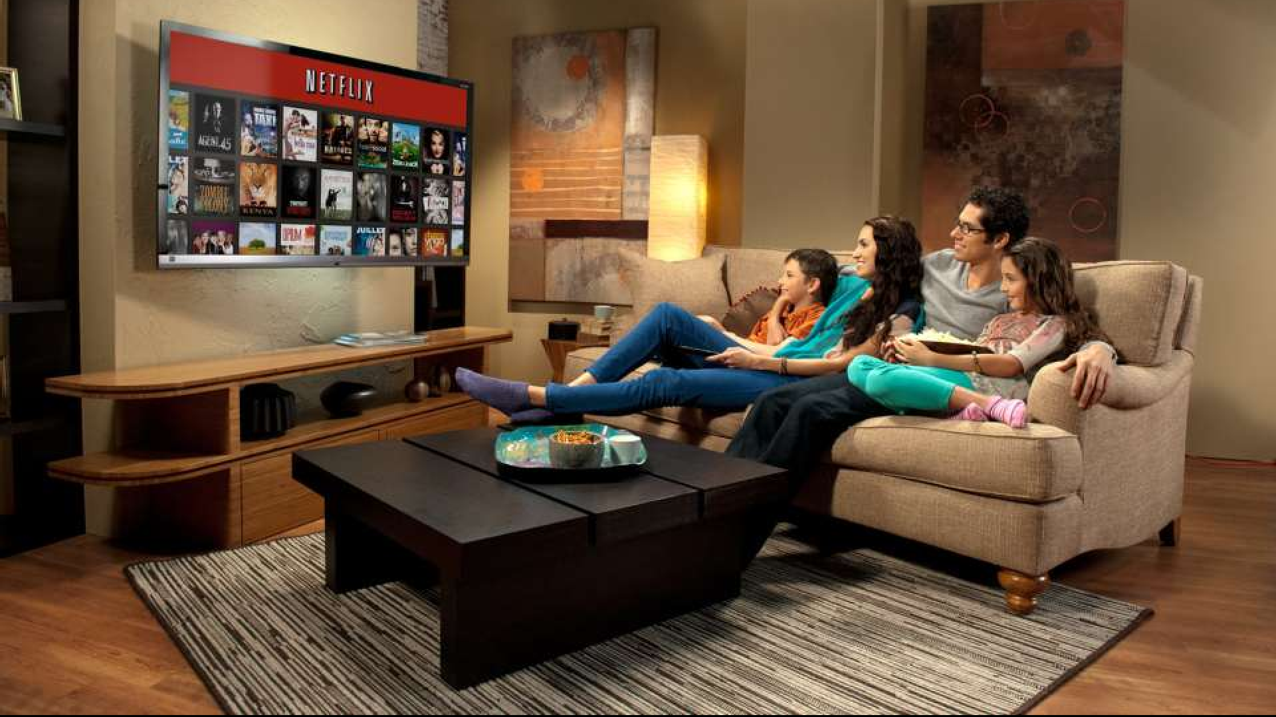
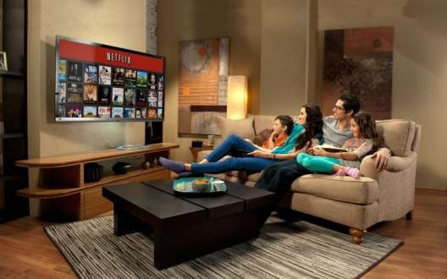
Motivation
Analyze the dataset obtained from Movielens, make some reasonable conjectures, support or refute those conjectures with data.
The essential goal is to give customers better recommendations of movies they will like.

Slide 3
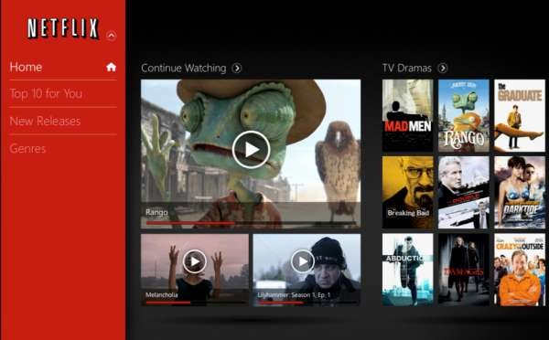
Content
1. Basic details of the data
2. Explore the scikit-learn TfidVectorizer class
3. Correlations of the data
4. Business Analysis

Slide 4
Basic details of the data
1. Download from http: //www. cs.cornell.edu/people/pabo/movie-review-data/
2. 1000 positive and 1000 negative reviews
3. Subdirectories: the true label of dataset

Slide 5
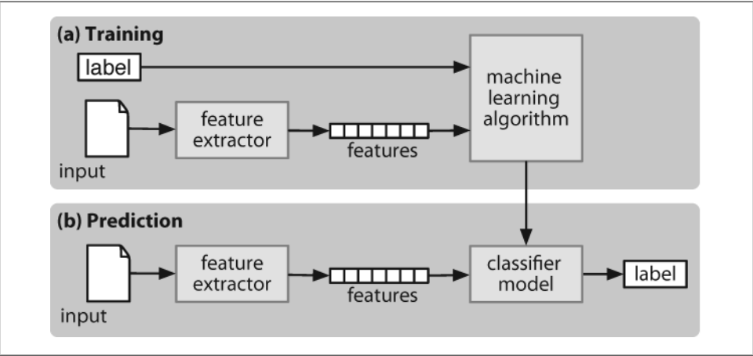
The process of sentiment classfication

Slide 6
The process of sentiment classification
Training:
Divide dataset into training and tuning dataset.
Feature extractor(eg. LDA, Tf-idf…) convert input to a feature set.
Generate model(eg. Naïve Bayes, SVM, KNN, LSTM…) and then tune parameters by grid search and c-v.
Prediction:
Use the same feature extractor and machine learning algorithm on test dataset(no label).

Slide 7
The result of Problem 1
 | LinearSVC | MultinomialNB | BernoulliNB
Precision-avg | 0.87 | 0.84 | 0.83
Recall-avg | 0.87 | 0.84 | 0.83
F1-score-avg | 0.87 | 0.84 | 0.83
Table 1. Comparison between different methods
in terms of combination of unigrams and bigrams
LinearSVC | (1,1) | (2,2) | (1,2)
mean | 0.83 | 0.83 | 0.85
std | 0.01 | 0.01 | 0.01
Table 2. Comparison between unigrams, bigrams and combination of them by using LinearSVC

Slide 8
Explore the scikit-learn TfidVectorizer class
1. Define the term frequency–inverse document frequency (TF-IDF)
2. Run the TfidVectorizer class on the training data
3. Explore the parameters of TfidVectorizer

Slide 9
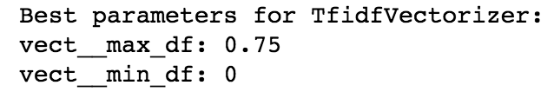
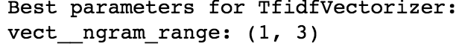
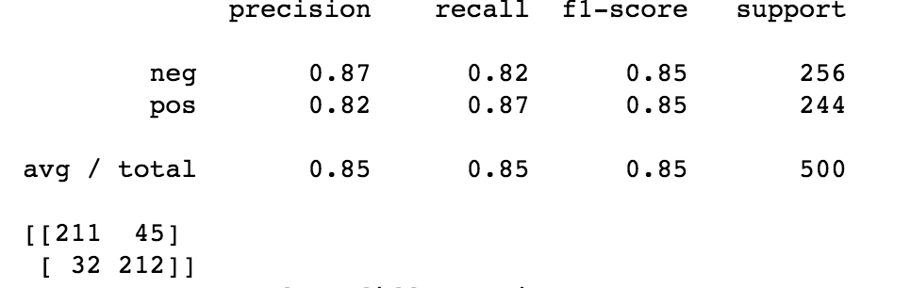
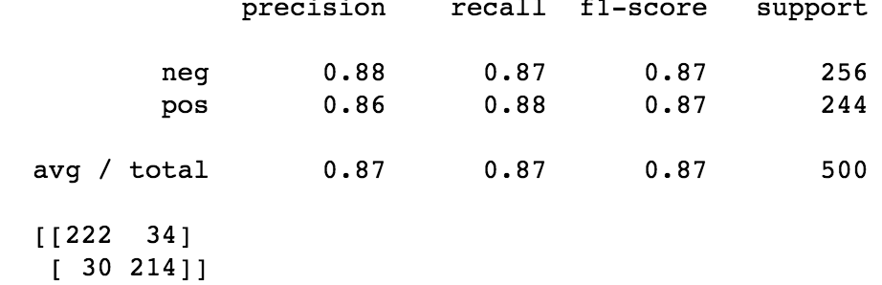
Explore the parameters of TfidVectorizer

Slide 10
Correlations of the data
1. Correlation: Men versus women
2.Conjecture for better prediction

Slide 11
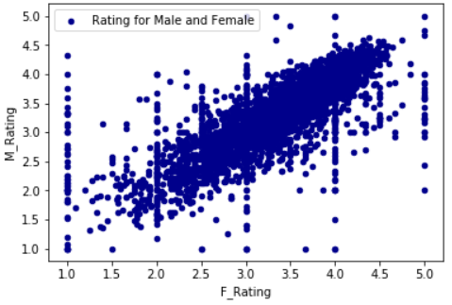
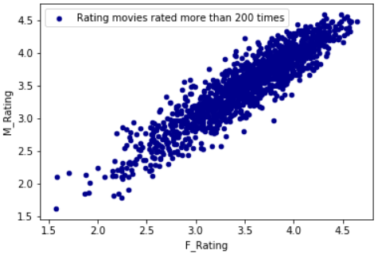
Scatter plot
rating for every movie
rating for movies rated more than 200 times

Slide 12
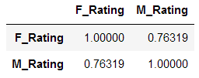
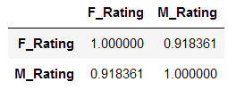
Conjecture for better prediction
correlation coefficient for every movie
correlation coefficient for movies rated more than 200 times
The coefficient increases from 0.76319 to 0.918361 men and women more similar when they are rating for the movies with large ratings.

Slide 13
The 2 Dimension Plot
1. A weighted score
2. Use a SVM

Slide 14
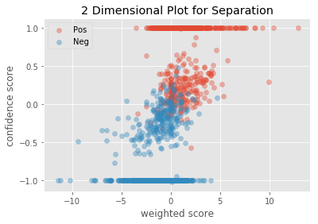

Slide 15
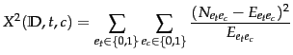
Weighted Score: Extract Words
We use chi2 to select 40 best features and then choose 20 of them.
In statistics, the chi2 test is applied to test the independence of two events
This score can be used to select the n_features features which are the most independent from other class

Slide 16
Weighted Score: Extract Words
Word
american | family | overall | terrible
attempt | great | perfect | true
awful | hilarious | perfectly | unfortunately
bad | life | poor | war
boring | looks | reason | waste
brilliant | memorable | ridiculous | wasted
dull | mess | script | wonderful
effective | minute | stupid | world
excellent | nothing | subtle | worse
fails | oscar | supposed | worst
40 words selected by Chi2

Slide 17
Weighted Score: Extract Words
word | POS | polarity | subjectivity
awful | NN | -1.0 | 1.0
bad | JJ | -0.6999999999999998 | 0.6666666666666666
boring | NN | -1.0 | 1.0
brilliant | NN | 0.9 | 1.0
effective | JJ | 0.6 | 0.8
excellent | NN | 1.0 | 1.0
great | JJ | 0.8 | 0.75
hilarious | JJ | 0.5 | 1.0
memorable | JJ | 0.5 | 1.0
perfect | NN | 1.0 | 1.0
perfectly | RB | 1.0 | 1.0
poor | JJ | -0.4 | 0.6
ridiculous | JJ | -0.3333333333333333 | 1.0
stupid | JJ | -0.7999999999999999 | 1.0
terrible | JJ | -1.0 | 1.0
true | JJ | 0.35 | 0.65
unfortunately | RB | -0.5 | 1.0
wonderful | NN | 1.0 | 1.0
worse | JJR | -0.4 | 0.6
worst | JJS | -1.0 | 1.0
20 words with subjectivity>0.5

Slide 18
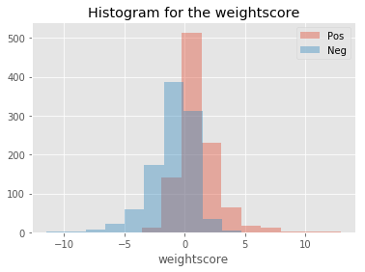
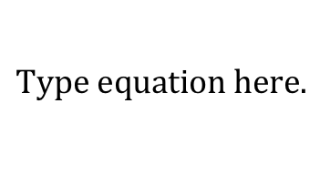
Weighted Score: How to calculate
The score = count of the word * subjectivity of the word * polarity of the word

Slide 19
SVM
Based on the Tfdif / With stopwords
Use confidence score

Slide 20
Evaluation
LDA
 | Precision | recall | f1-score | support
Neg | 0.93 | 0.90 | 0.92 | 494
Pos | 0.91 | 0.93 | 0.92 | 506
avg/total | 0.92 | 0.92 | 0.92 | 1000

Slide 21
